Slide 1
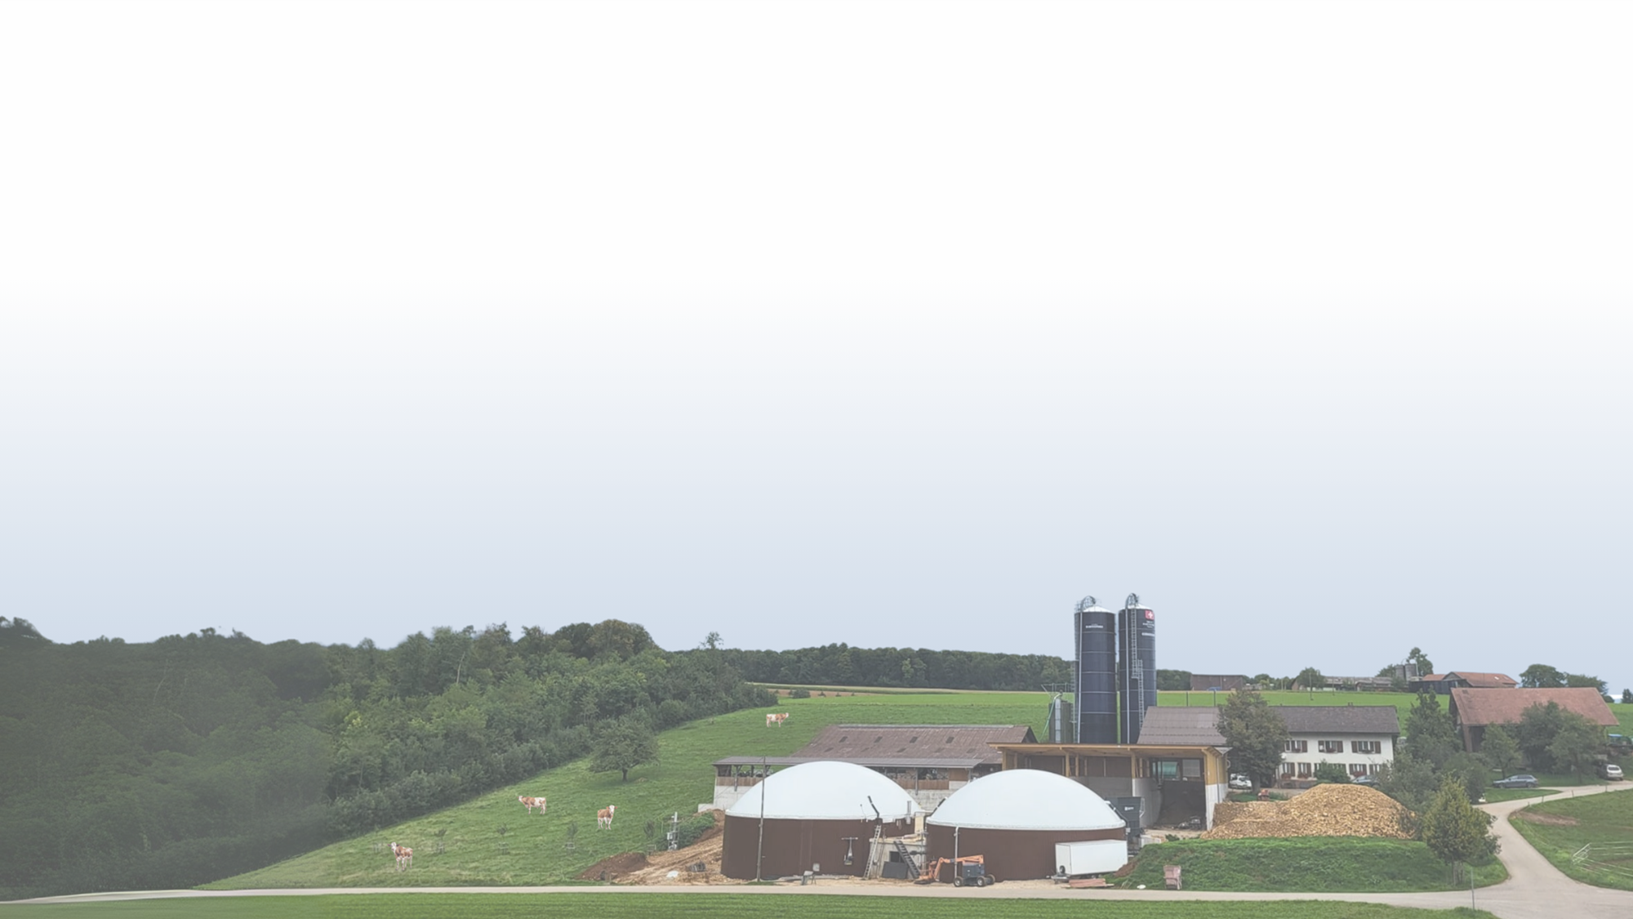

Farmers and Biogas Plant Collective Dynamics:
an Agent Based Model
Alina Akopian, Ross Roessler, Sandrine Werner
08.12.25

Slide 2
Introduction

Slide 3
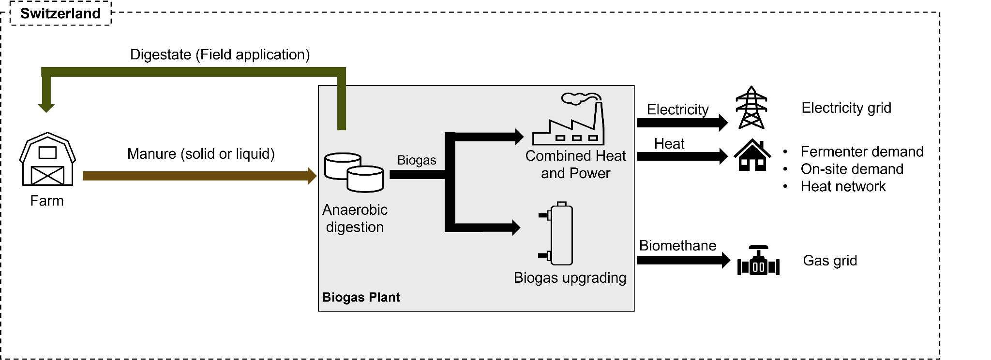
Problem Statement
•Livestock produces considerable amount of manure ~24 million tonnes per year
•Currently, <5 % is used for energy → largely untapped potential
•Manure-to-energy pathways:

Slide 4
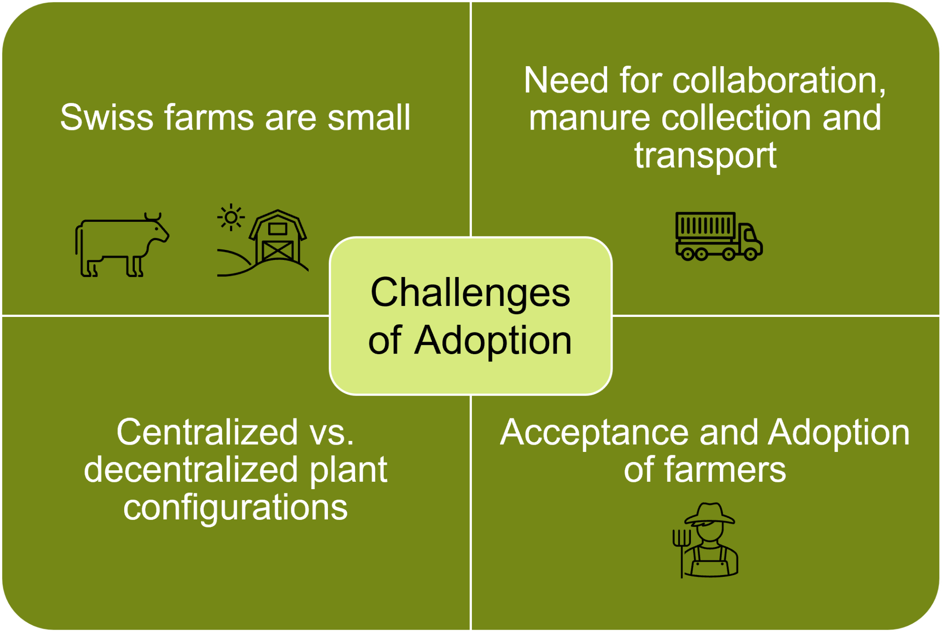
Problem Statement

Slide 5
Research Questions
Old ones:
RQ1: How do heterogeneous farmer preferences and collaboration dynamics shape the emergence and scale of manure-to-energy pathways in Switzerland?
RQ2: How do different policy levers (e.g., subsidy levels) interact with these collaboration dynamics to accelerate or hinder the adoption of manure-to-energy pathways and the achievement of specific environmental targets (e.g., maximize the avoided greenhouse gas emissions)?
RQ1: How do heterogeneous farmer preferences and collaboration mechanisms influence the emergence, adoption and size distribution of manure-to-energy installations in Switzerland?
RQ2: How do policy incentives (e.g., subsidy levels) and learning dynamics interact with collaboration mechanisms to influence the scale of biogas adoption?

Slide 6
Related Work

Slide 7
Related Work
Farmer’s willingness to adopt private and collective biogas facilities: An agent-based modeling approach (Burg et al. 2021) - analysis of current Swiss situation
Surveyed distribution of Swiss farmers, situations, and beliefs
ABM to match current Swiss plant distribution
Simulated economic factors (subsidies)
Cooperation in manure-based biogas production networks: An agent-based modeling approach (Yazan et al. 2017) - ABM for Netherlands
Farmers and biogas producers separate agents
Interesting economic incentives due to legal regulations
Requirement to remove manure, more expensive during some months
Found distance to be very important factor
Improving diffusion in agriculture: an agent-based model to find the predictors for efficient early adopters (Barbuto et al. 2019)
Closeness and clusterization most important in spreading early adoption
Notes:
So I would say that Burg kind of kept it more "factual", like, they tried to match the real personalities and then simulate "how do economic factors impact it"? We consider economic factors, but also experimented with different actual distributions, behavioral parameters, etc.
In Yazan, distance was important because 1) large farms benefited from economies of scale but currently had to pay more to get rid of their manure, so it makes sense for the biogas plants to be located nearer to large farms and 2) the distance between the farms and the arable lands (where they can dump the manure) affected the pricing and the willingness to contribute to biogas plants instead.

Slide 8
Model

Slide 9
Model basics & structure
Grid of farmers (20×20 cells), each representing a livestock farm
Two agent types:
Farmers: decide to build or contribute to a biogas plant
Biogas plants: created when farmers invest; different sizes and economies of scale
Adoption influenced by:
Global learning (time-based awareness)
Social learning (adoption of neighbors)
Economic utility (NPV-based decision)
Output metrics:
Number and size of plants, adoption timing, kW installed, contributors

Slide 10
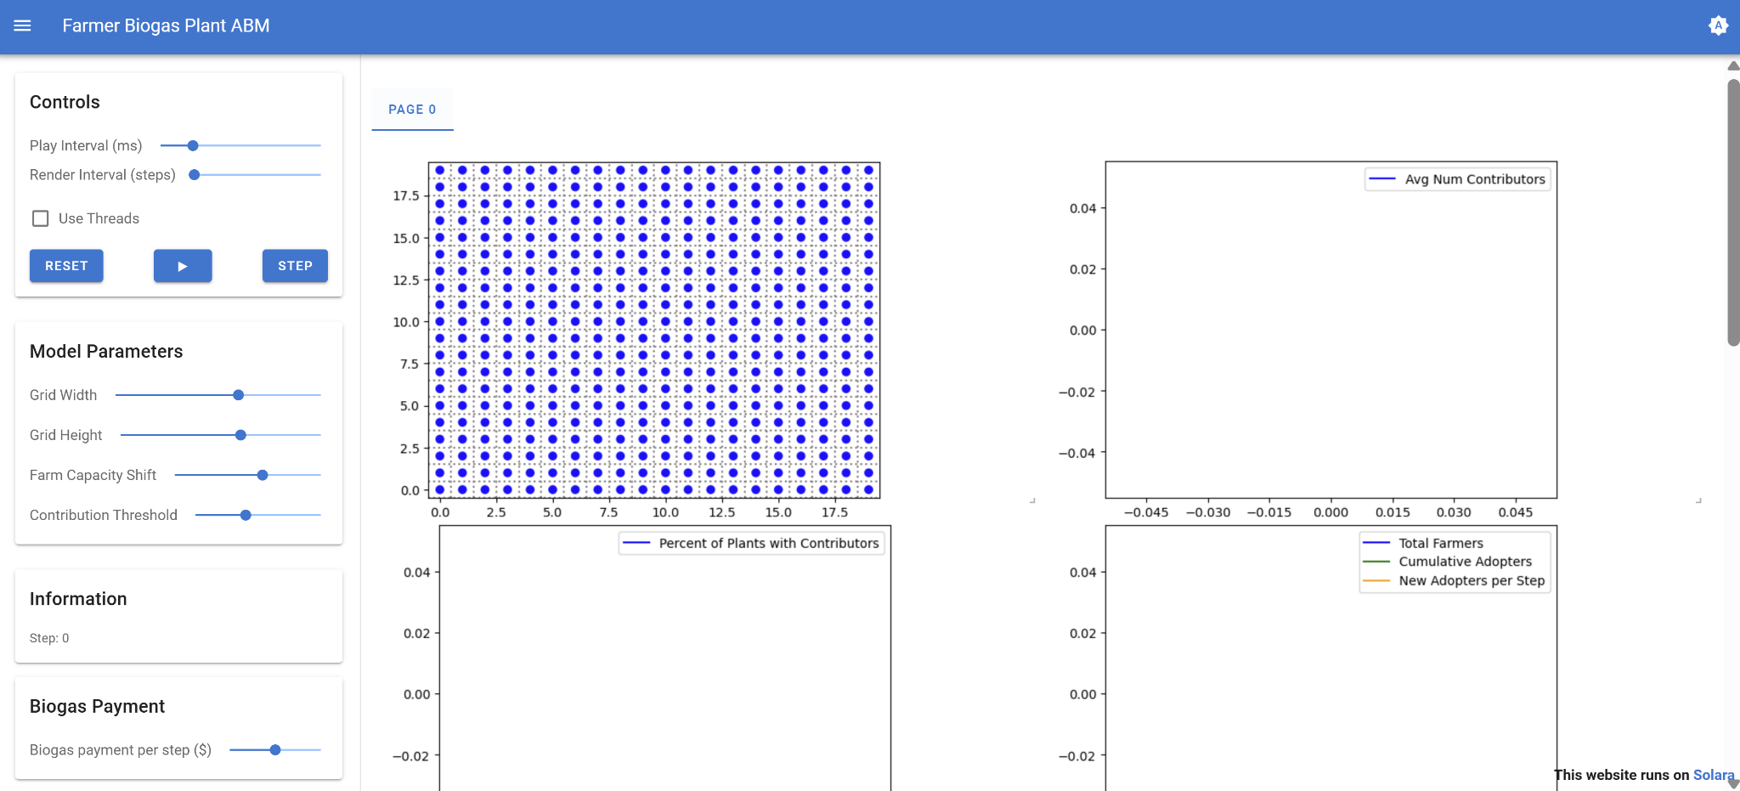
Model basics & structure
Built using the Mesa Python framework for agent-based modeling
Includes an interactive Solara interface for exploring model dynamics

Slide 11
Farmers
Attributes
Livestock - sampled from Swiss distribution
Two willingness parameters - to build and contribute
"innovators" and "majority"
Updates
Willingness - global and social
Decisions
Build
Contribute
Notes:
The willingnesses have a max possible value also.

Slide 12
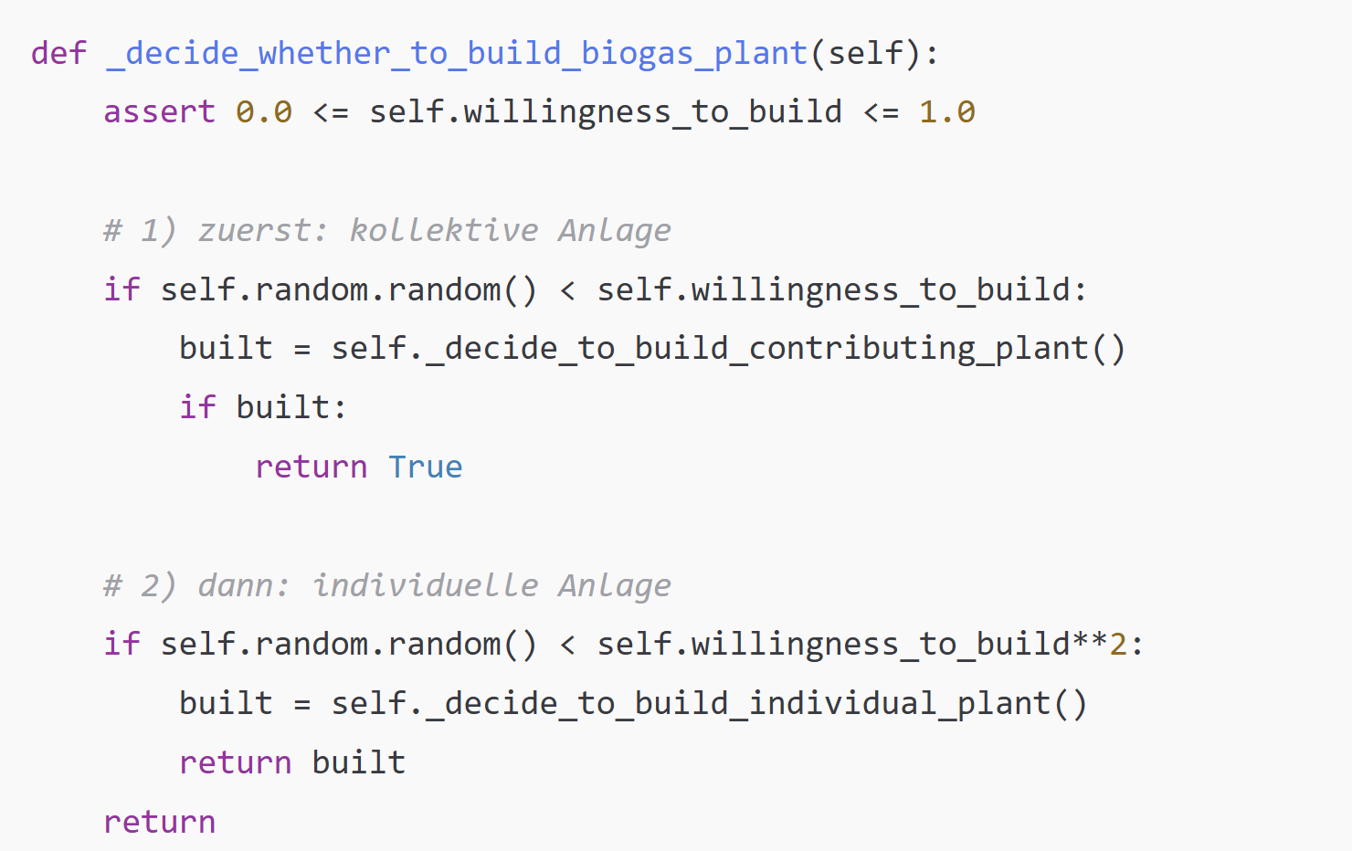
Decision logic of a farmer
No further adoption decisions
Yes
Build individual plant
Is a farmer already part of a plant
No
Update learning and willingness
Attempt to build a plant
Economic viability check
Build collective plant
Apply global learning curve
Compute social learning based on neighbors
Update willingness to build and contribute
Collective plant
Individual plant
Compute utility (NPV+co-owner penalties)
Compare to minimum threshold
Do not build

Slide 13
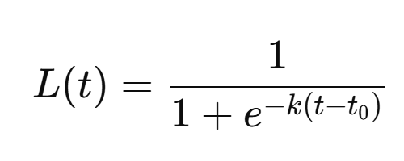
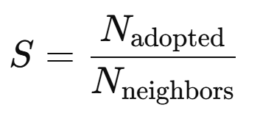
Learning mechanisms
Global learning (time-based):
Modeled as a logistic S-curve
k: learning_rate (steepness)
t0: learning_midpoint
→ represents rising awareness and innovation diffusion
Social learning:
Fraction of adopted neighbors in radius-2 neighborhood
→ represents learning from the local social environment

Slide 14
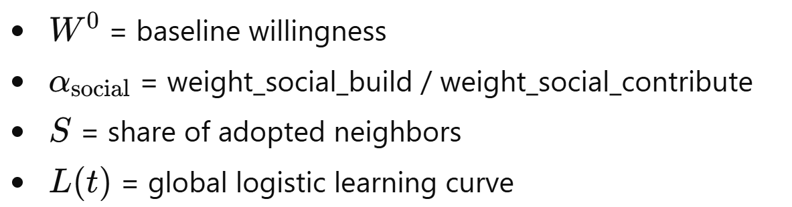
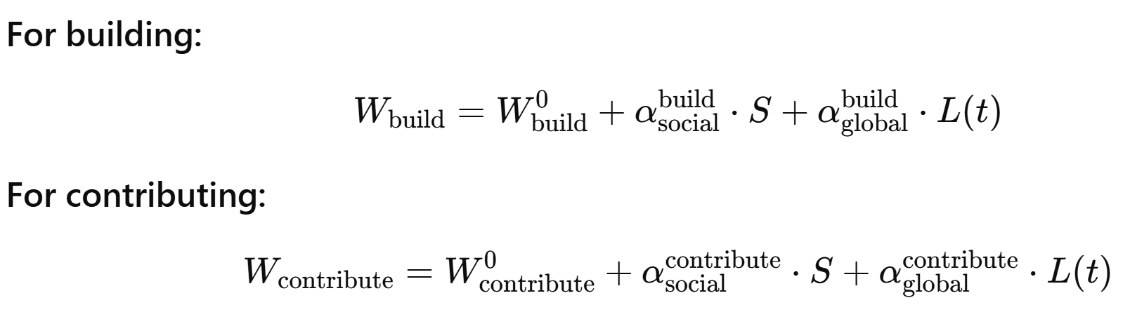
Learning mechanisms
Global learning (time-based):
Modeled as a logistic S-curve
k: learning_rate (steepness)
t0: learning_midpoint
→ represents rising awareness and innovation diffusion
Social learning:
Fraction of adopted neighbors in radius-2 neighborhood
→ represents learning from the local social environment
Willingness Equation:
For building:
For contribution:

Slide 15
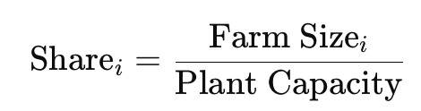
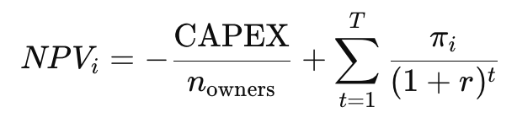
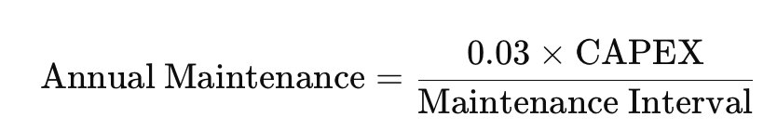
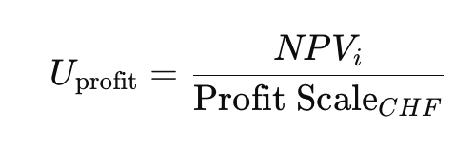
Economic utility function
3. Farmer’s share of plant output
Net Present Value utility function
Utility combines economic profitability and a penalty for co-ownership
Higher utility leads to higher probability of adoption
4. Annual net profit for farmer
5. NPV
Economic Component
1. Annual revenue
2. Annual maintenance
6. Utility from profit (scaled)
Notes:
Perceived economic attractiveness of building a biogas plant.

Slide 16
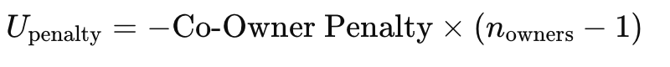
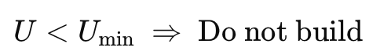
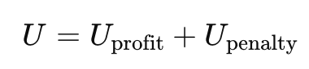
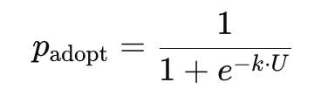
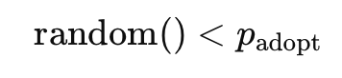
Social Component
Each additional co-owner reduces utility
Adoption decision rule
Hard threshold
Total Utility
Probabilistic decision
Farmers adopt if

Slide 17
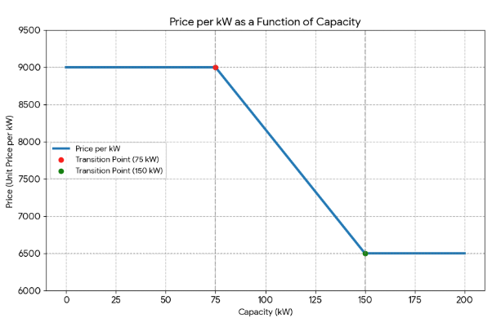
Plant building and output
Two parameters
Building cost
Efficiency (kW per substrate)
Modeled using real-world cost and output estimates from Germany
Larger plant → decreasing $ / kW
Larger plant → increasing efficiency
Use latest Swiss biogas subsidies
Realistic capacity requirements and constraints
Notes:
I could include a graph here, but they are just linear functions.

Slide 18
Plant building and output
Simplifications - we don't model:
Physical (land) constraints
Operational labor overhead - generally considered minimal
Multiple owners - no data

Slide 19

Model output

Slide 20
Performance Evaluation Metrics

Slide 21
Calibration
We match realistic Swiss distributions and pricing from [Burg et al., 2021]
Livestock distribution, plant costs and output, subsidies
Calibrate on: resulting plant distribution
Fraction of individual vs. communal plants
Average number of contributors
Calibration Parameters:
Willingness to build and contribute
Required utility
Co-owner penalty

Slide 22
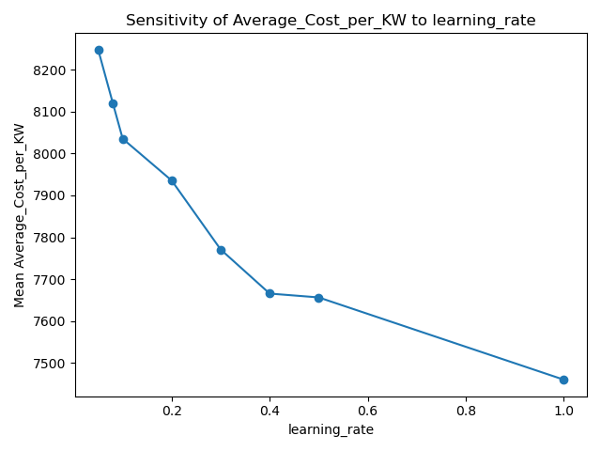
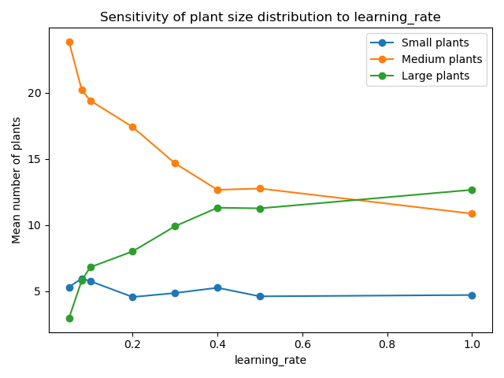
Sensitivity analysis - Learning mechanisms
Most parameters behave as expected
Higher learning rates lead to higher adoption
Earlier learning increases willingness and cooperation
Constant decrease

Slide 23
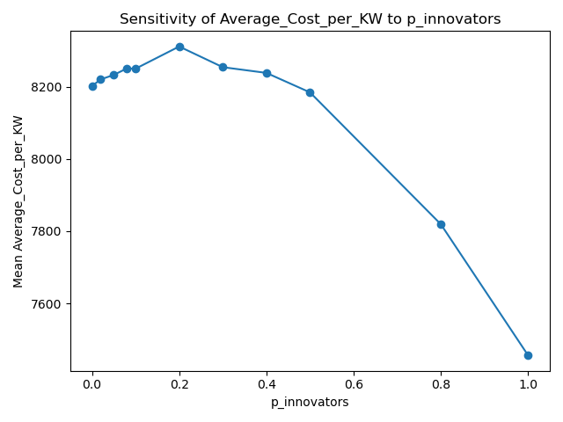
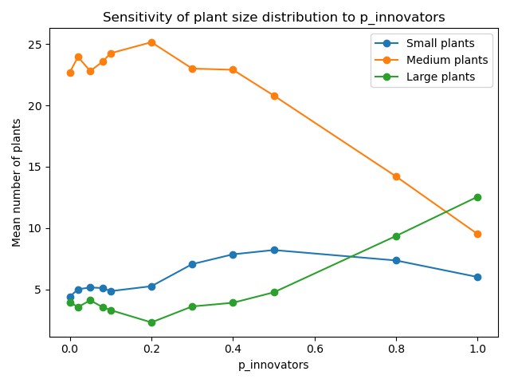
Sensitivity analysis - Learning mechanisms
Innovator share:
Expected: Higher innovator shares improve economic performance
Reality: Moderate innovator share (~20%) produces worst economic output
High innovator share triggers cooperation → shift to larger plants
Notes:
-At ~20% innovators, farmers adopt early but mostly individually, creating many medium plants with high cost/kW.
-Only at higher innovator shares does cooperation scale up, leading to fewer, larger plants and lower costs.

Slide 24
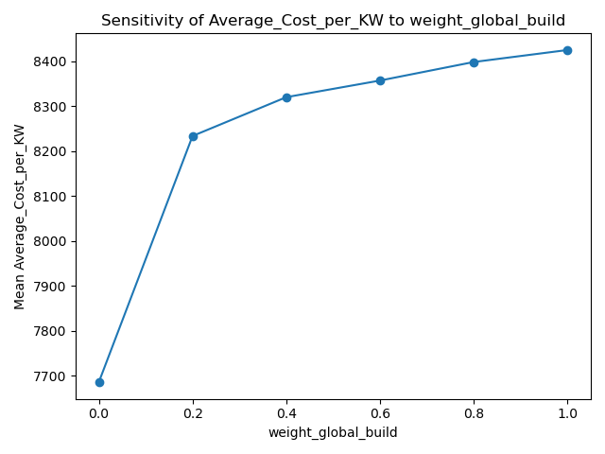
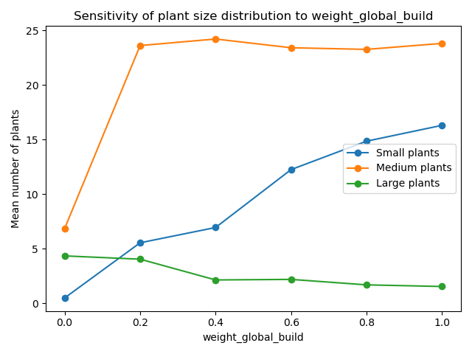
Sensitivity analysis - Learning mechanisms
Global weight:
To build:
Expected: Increase adoption (more farmers build or contribute)
Reality: Adoption increases, but mostly through many individual plants This leads to more installations, but not more efficient ones.
Notes:
Individualistic motivation increases deployment—but collective motivation increases efficiency.

Slide 25
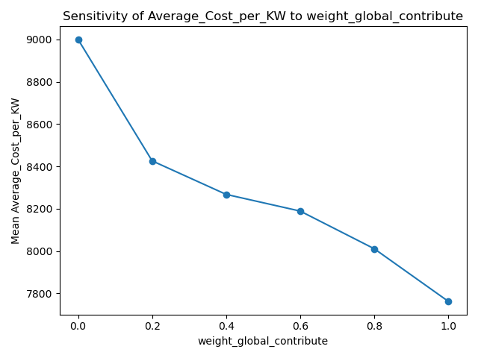
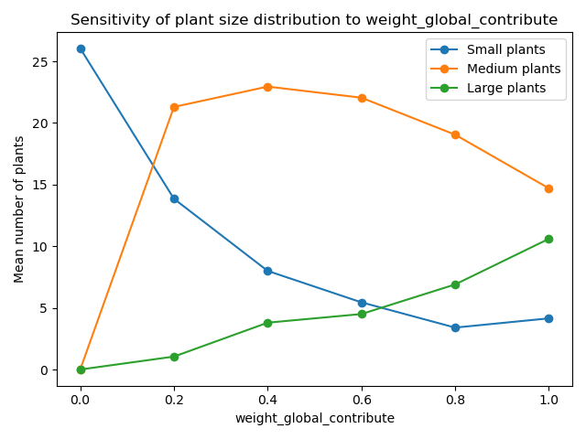
Sensitivity analysis - Learning mechanisms
Global weight:
To contribute:
Individual motivation increases deployment, but collective motivation increases efficiency
Expected: Increase adoption (more farmers build or contribute)
Reality: Strong global contribution weight increases cooperation This leads to more large plants and lower costs
Trade-off
Notes:
Individualistic motivation increases deployment—but collective motivation increases efficiency.

Slide 26
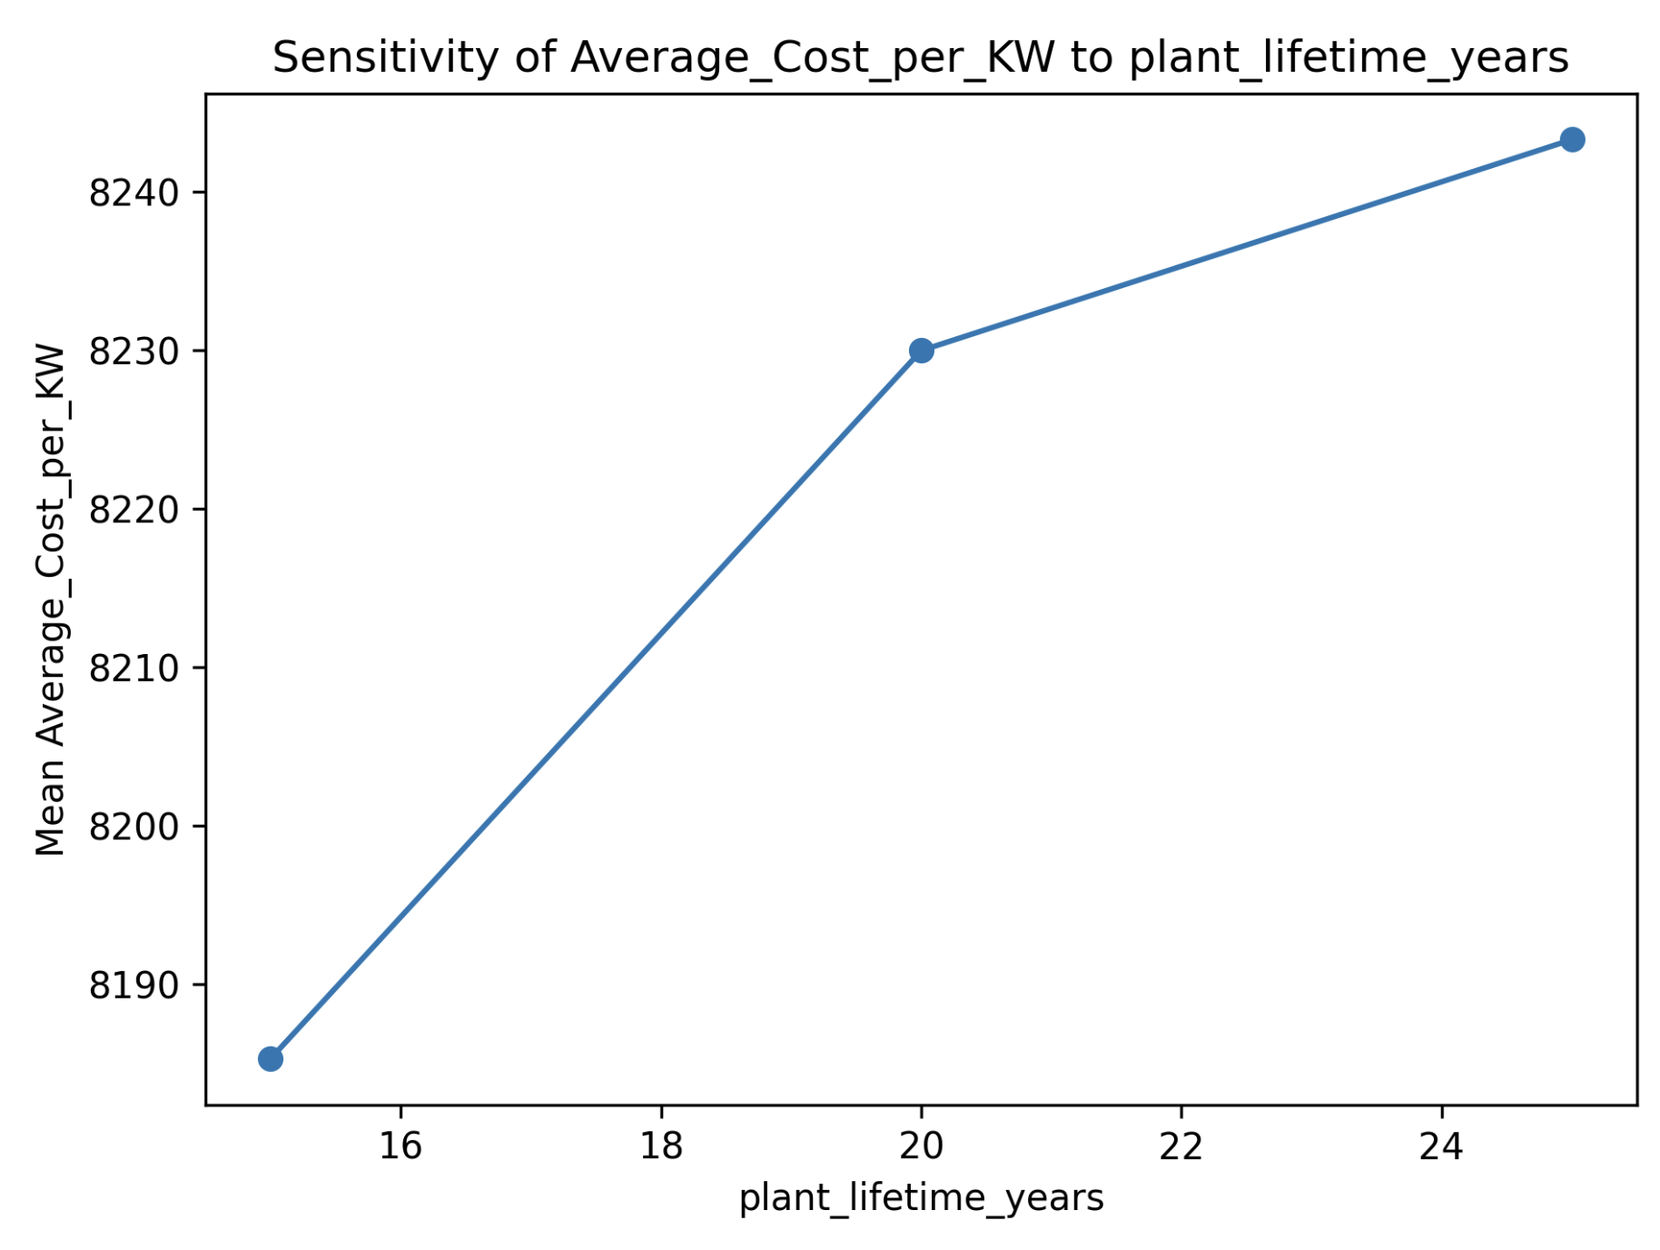
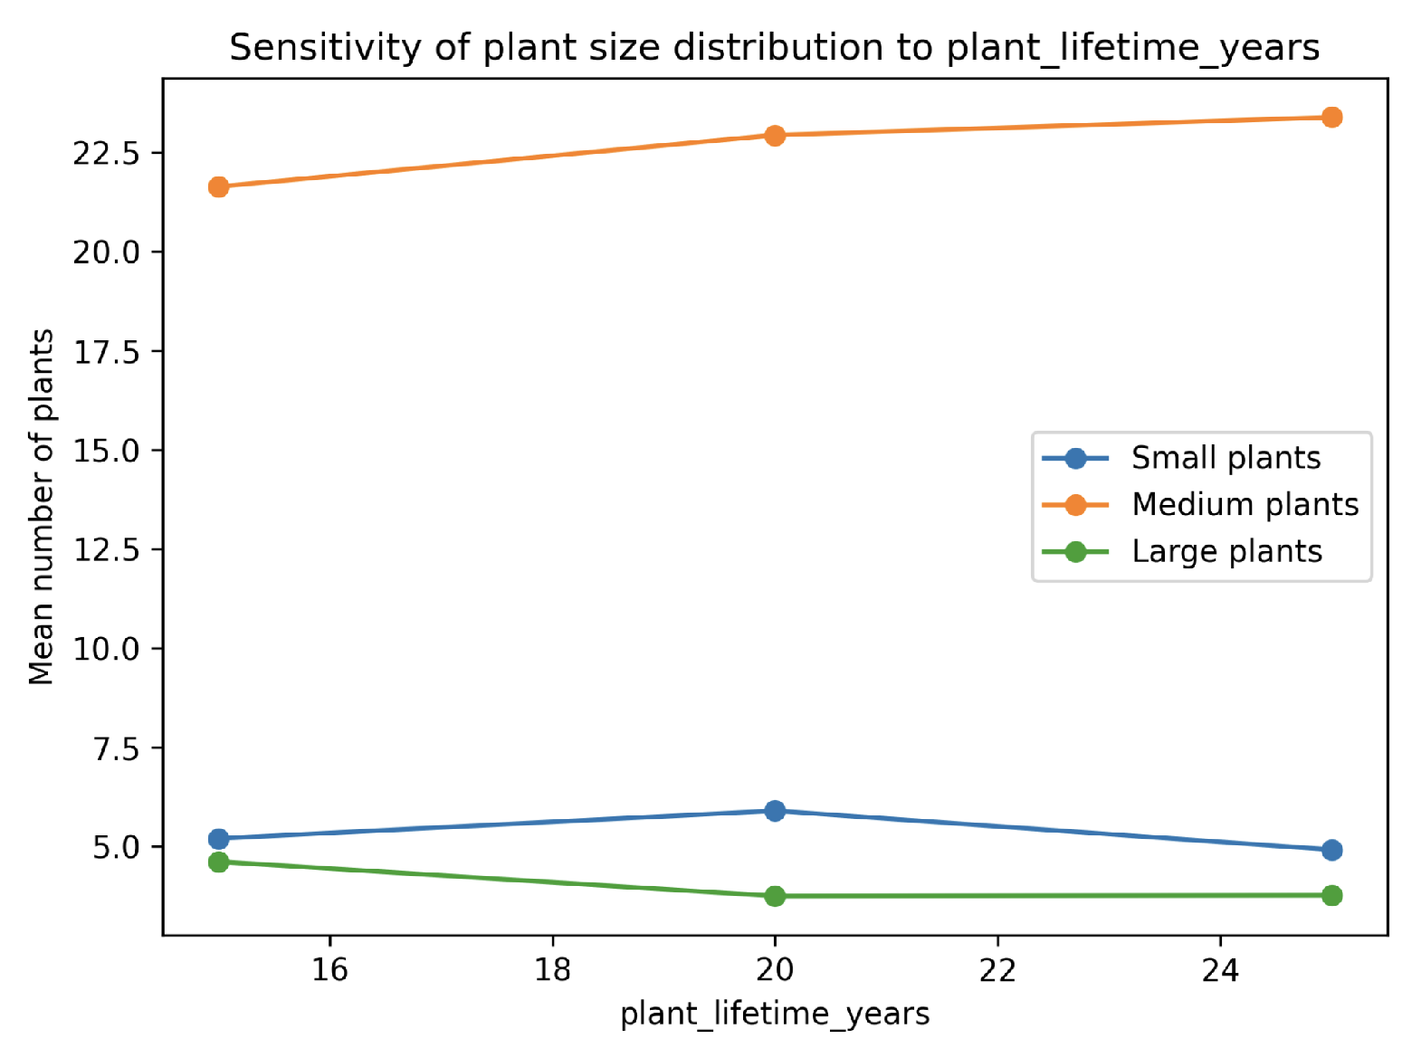
Sensitivity analysis - Subsidy / Economic
Mostly "expected"
Increasing farm capacity → more adopters and plants
Lower economic costs → more adopters and plants
Increasing subsidies → generally increases plants
Insensitive parameters such as utility minimum threshold or plant lifetime
Limited influence on model output

Slide 27
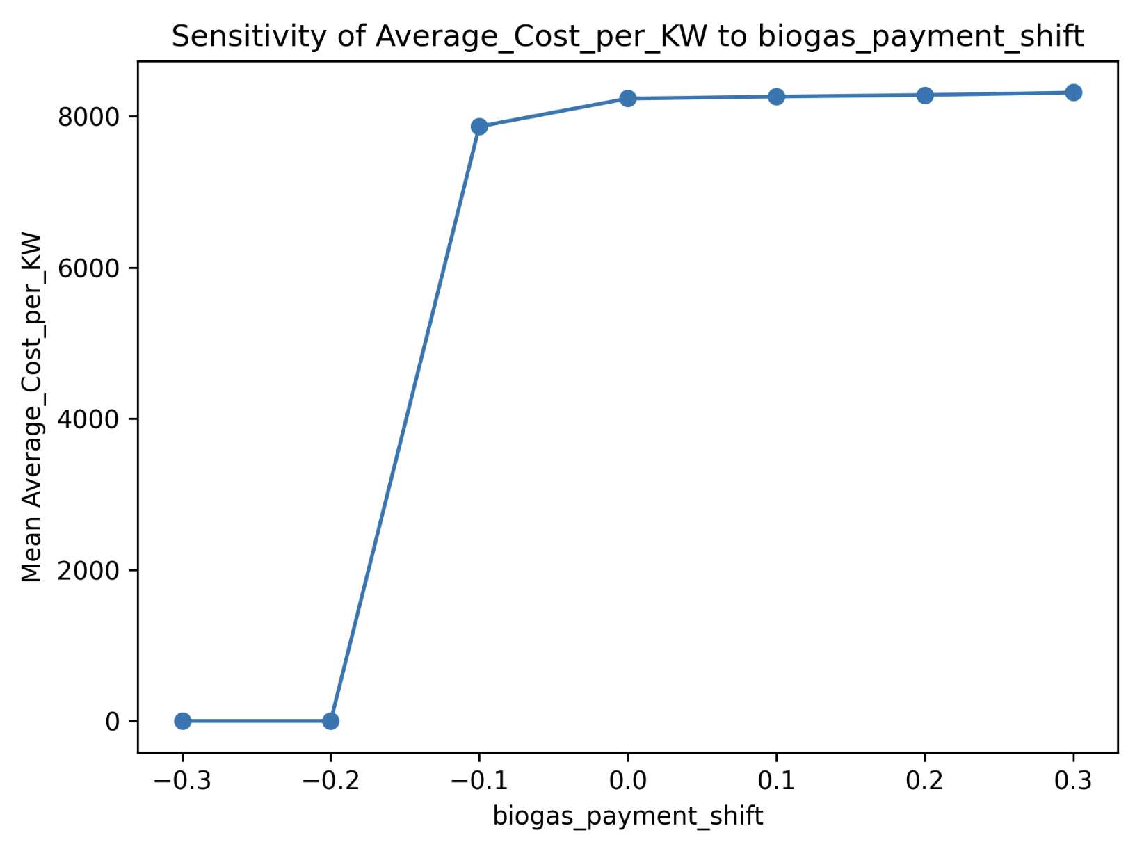
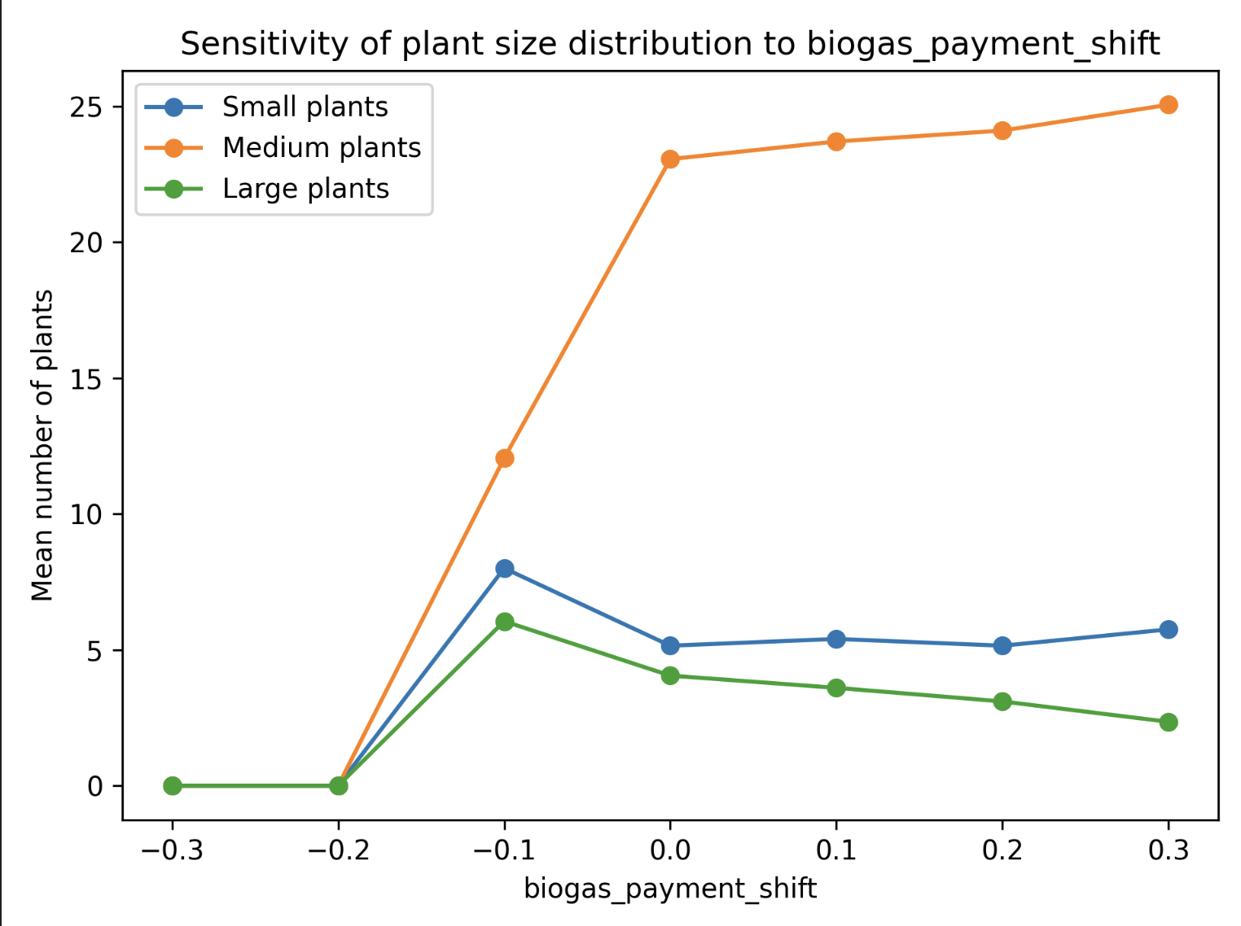
Sensitivity analysis - Subsidy / Economic
Biogas payment shift (subsidies)

Slide 28
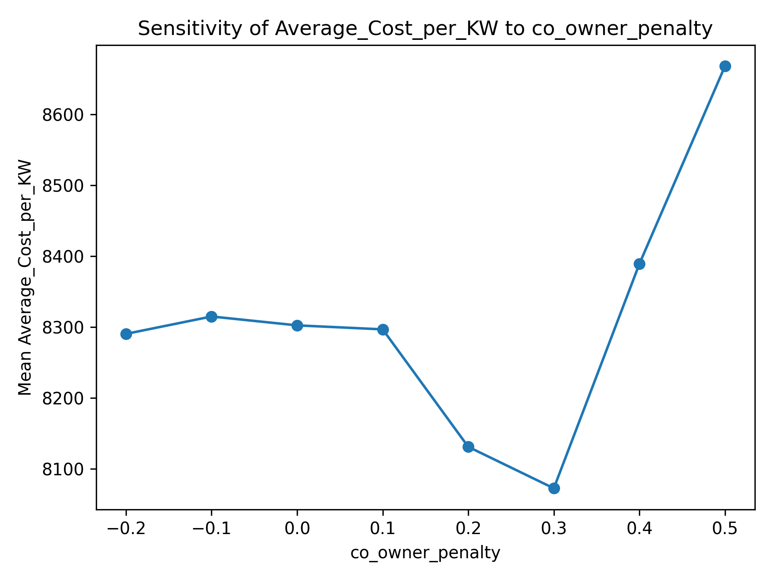
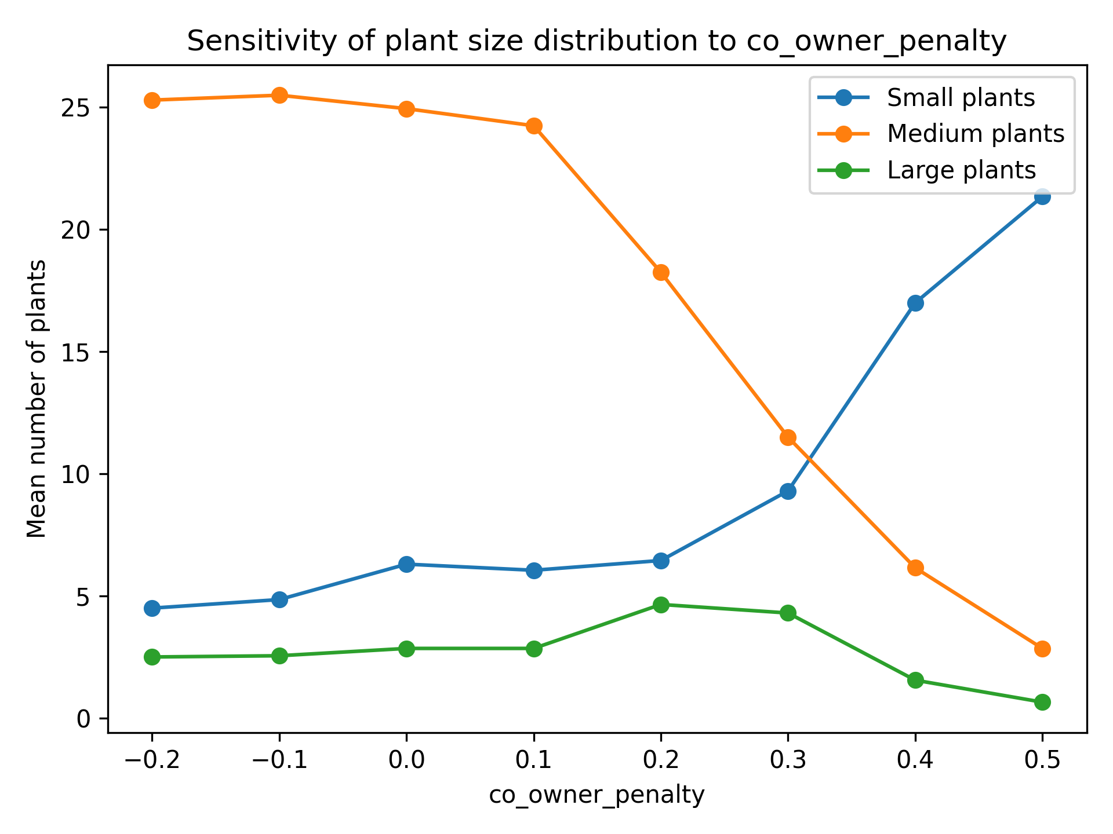
Sensitivity analysis - Subsidy / Economic
Unexpected - co-owner penalty - financial penalty on collaboration
Expected: more small plants -> higher costs
Reality: cheapest in middle
More large plants being built
Notes:
The Medium plants are affected first. Which maybe makes sense, because now people only build plants if there's a stronger economic reason. But the Medium plants decrease more quickly than the small ones increase, and the large ones do increase slightly as well, because more collaborators are available.

Slide 29
Discussion & Conclusion

Slide 30
Discussion
RQ1: How do heterogeneous farmer preferences and collaboration mechanisms influence the emergence, adoption and size distribution of manure-to-energy installations in Switzerland?
Answer: different "levers" have very different impacts on plant size distribution
Making farmers more likely to build increases small plants
Increasing subsidies increases medium plants
More innovation increases large plants
The question becomes: what outcome does Switzerland want?

Slide 31
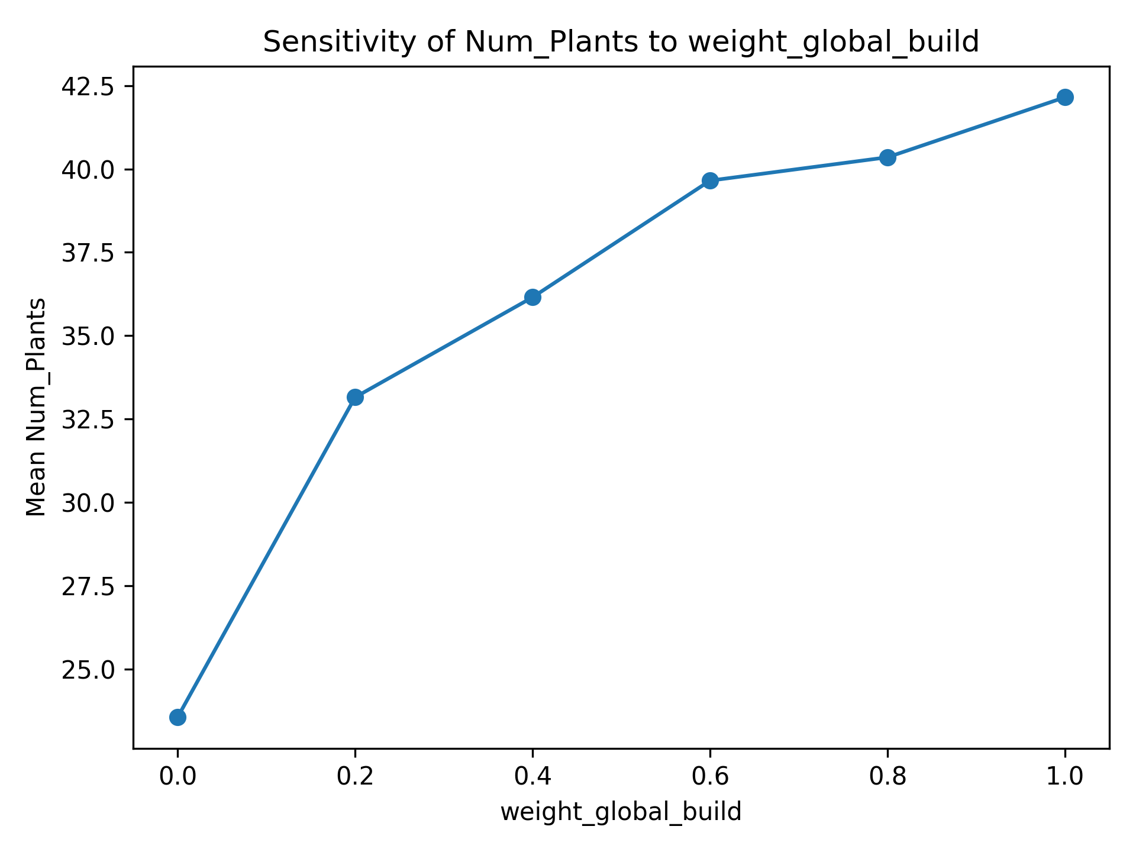
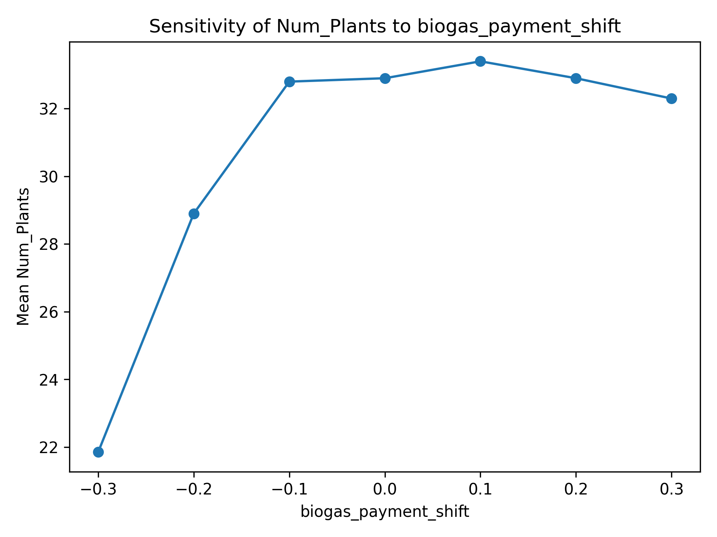
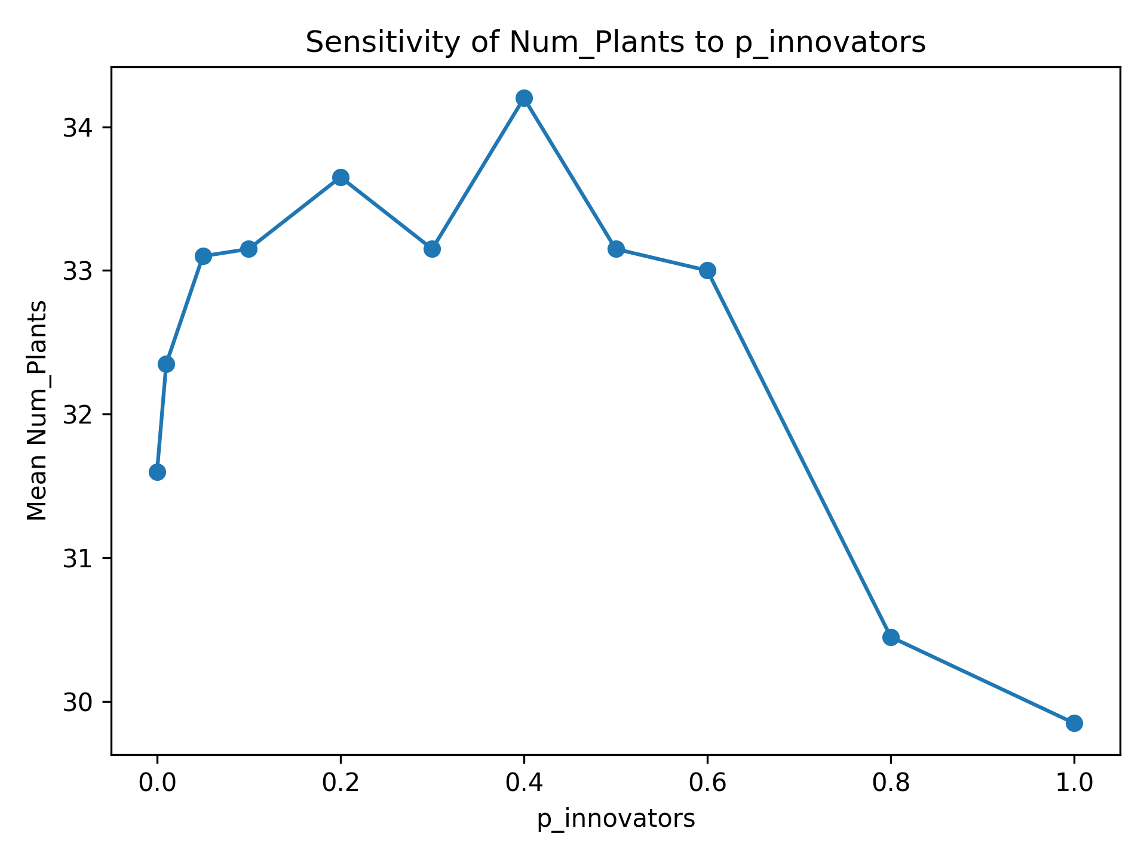
Discussion
RQ2: How do policy incentives (e.g., subsidy levels) and learning dynamics interact with collaboration mechanisms to influence the scale of biogas adoption?
Similarly, we see that different incentives change the final number of plants.
Interestingly, for all these graphs, total final adopters remains relatively unchanged.

Slide 32
Conclusion
Our model highlights how economic incentives, social learning and collaboration dynamics jointly shape biogas development
Subsidies and willingness both raise adoption, yet the resulting plant sizes differ
Possible conclusion - more worthwhile to spend money on advertising + knowledge sharing
But - contingent on several assumptions:
Farmers can initially afford plants
Plants can be built anywhere
Subsidies stay in place forever
It's complicated and depends on what Switzerland wants

Slide 33
Future Work
Physical constraints - modeling actual topology, land constraints on building
Key factor in the Netherlands
Multiple owner plants and associated willingness
Economic modeling for contributors
Actual market dynamics
Adoption speed

Slide 34
References
1. Vanessa Burg, Klaus G. Troitzsch, Deniz Akyol, Urs Baier, Stefanie Hellweg, Oliver Thees, Farmer's willingness to adopt private and collective biogas facilities: An agent-based modeling approach, Resources, Conservation and Recycling, Volume 167, 2021, 105400, ISSN 0921-3449, https://doi.org/10.1016/j.resconrec.2021.105400.
2. Devrim Murat Yazan, Luca Fraccascia, Martijn Mes, Henk Zijm, Cooperation in manure-based biogas production networks: An agent-based modeling approach, Applied Energy, Volume 212, 2018, Pages 820-833, ISSN 0306-2619, https://doi.org/10.1016/j.apenergy.2017.12.074.
3. Barbuto, A., Lopolito, A. & Santeramo, F.G. Improving diffusion in agriculture: an agent-based model to find the predictors for efficient early adopters. Agric Econ 7, 1 (2019). https://doi.org/10.1186/s40100-019-0121-0
4. Djatkov, Djordje & Viskovic, Miodrag & Martinov, Milan & Nesterovic, Aleksandar & Bojic, Savo & Effenberger, Mathias & Venus, Thomas J.. (2021). Small biogas plants. 10.13140/RG.2.2.20644.40321.
5.https://www.dvl.org/uploads/tx_ttproducts/datasheet/DVL-Publikation-Schriftenreihe-22_Vom_Landschaftspflegematerial_zum_Biogas-ein_Beratungsordner.pdf

Slide 35
Appendix

Slide 36
Sensitivity analysis - Learning mechanisms
Learning rate:

Slide 37
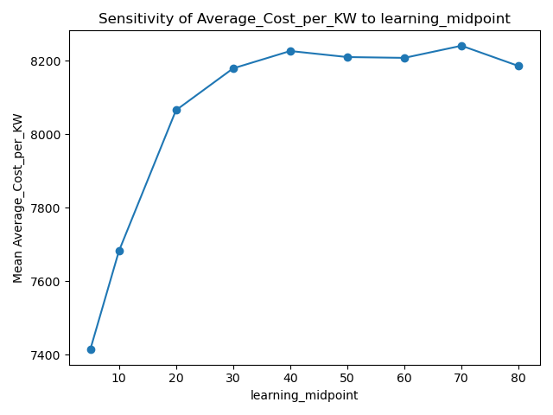
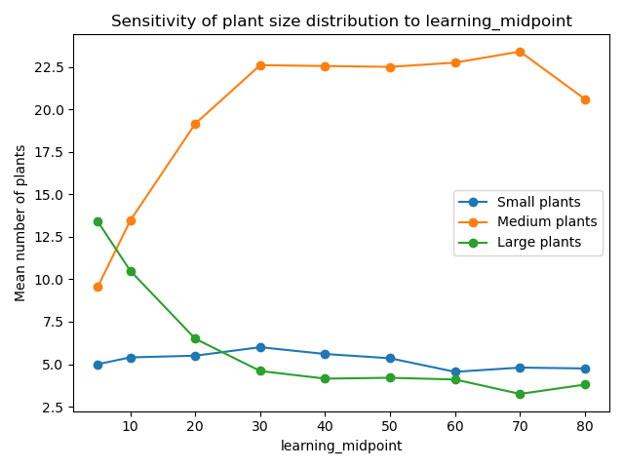
Sensitivity analysis - Learning mechanisms
Learning midpoint:

Slide 38
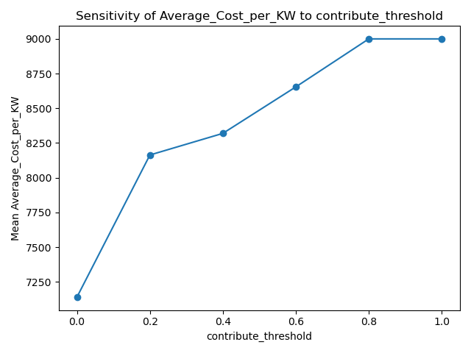
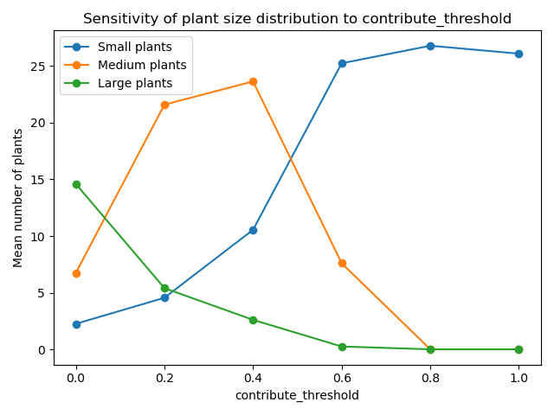
Sensitivity analysis - Learning mechanisms
Contribute threshold:

Slide 39
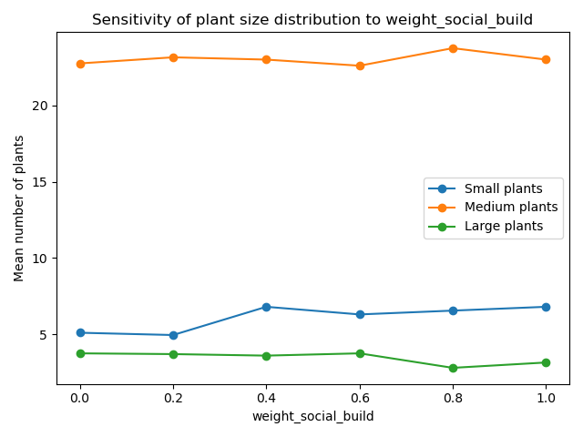
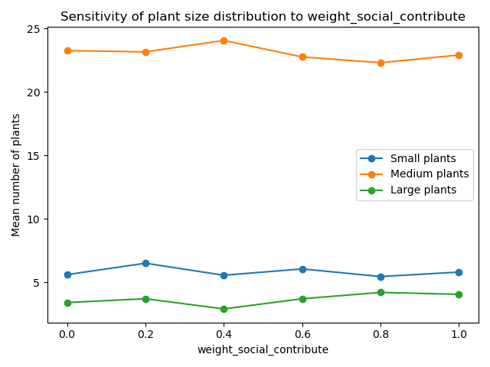
Sensitivity analysis
Social weight:
To build: To contribute:
Expected: Social learning should increase adoption
Reality: Social weights show very limited influence on plant size outcomes
Adoption patterns remain almost unchanged across the parameter range

Slide 40
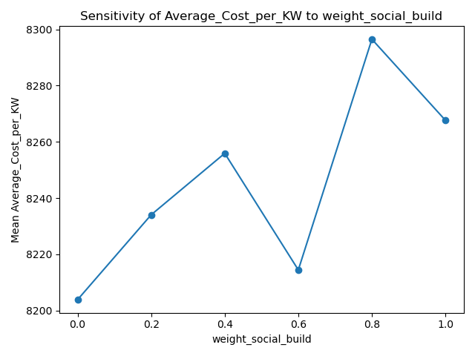
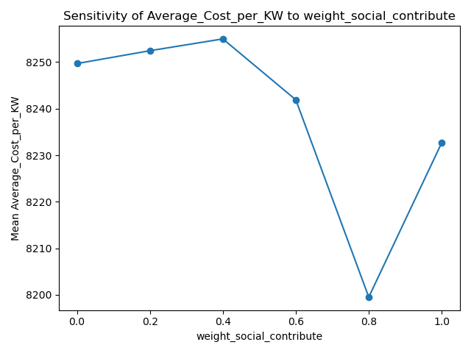
Sensitivity analysis
Social weight:
To build: To contribute:

Slide 41
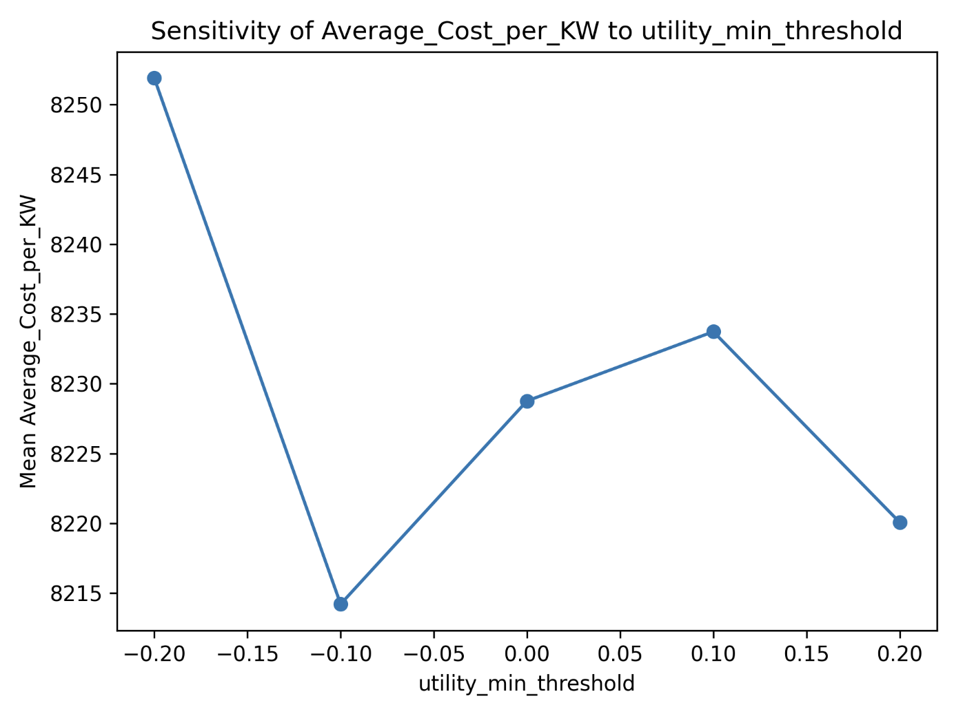
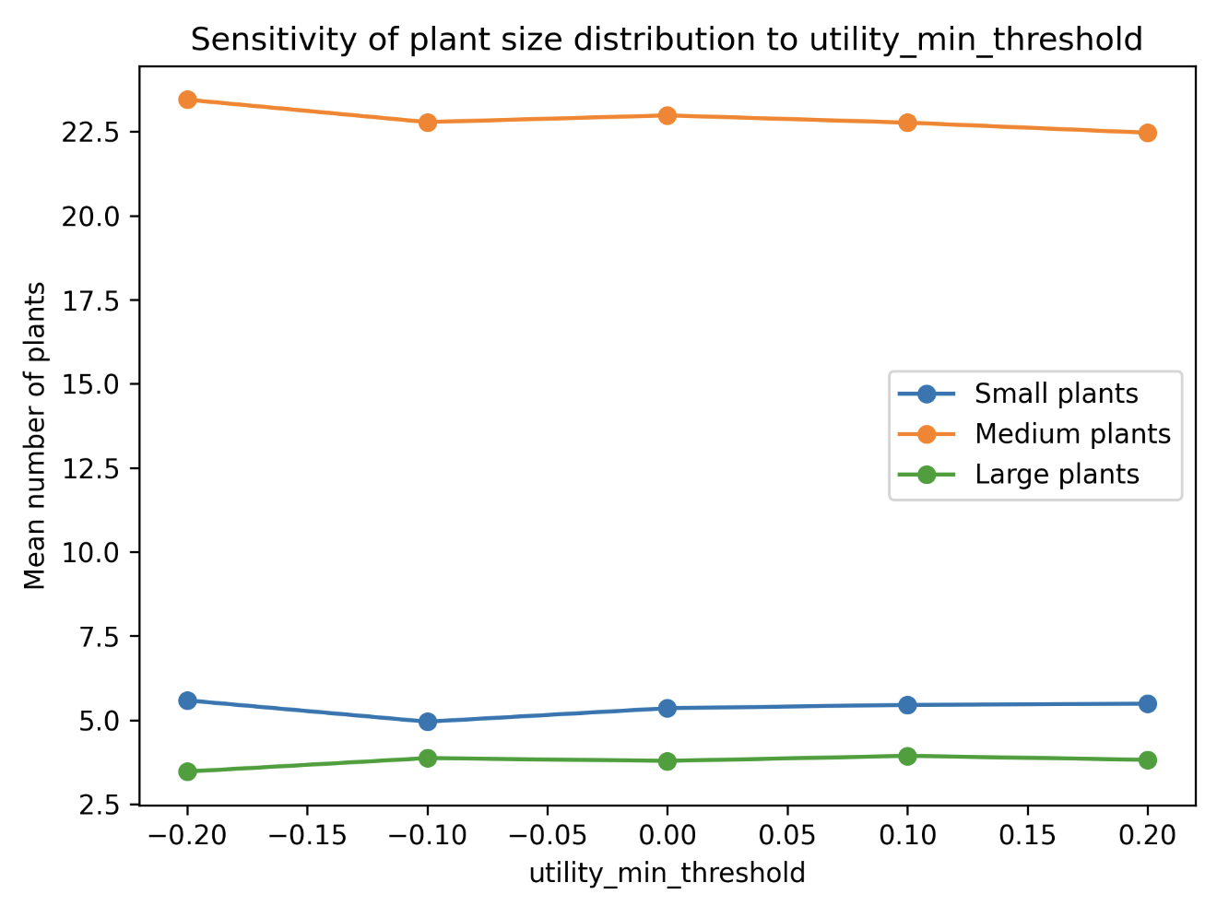
Sensitivity analysis
Utility minimum threshold
Notes:
As min threshold decrease, the costs per kW increase, since everyone is adopting/building smaller farms. As min threshold increase, the costs decrease since only the most efficient plants are built.

Slide 42
Sensitivity analysis
Plant lifetime years
Notes:
Our model assumes that the first investment made is the same regardless of the plant lifetime. Thus, more farmers adopt biogas plants if that means they are able to profit from them for longer period of time, given the same investment.

Slide 43
